Slide 1

SwiftUI
Overview & Introduction
By:
Andres Parejo
iOS Developer

Slide 2
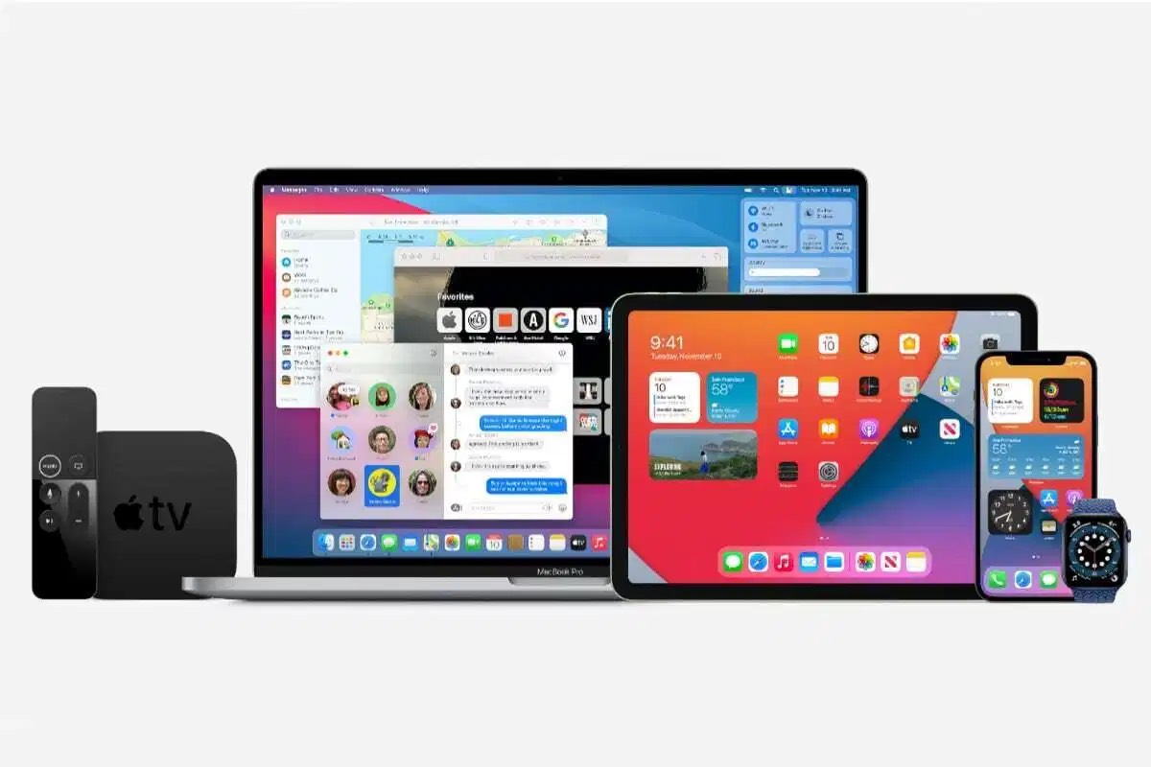
What’s new in SwiftUI
Advanced app experiences and tools
Accessibility improvements
SwiftUI improvements on macOS
Always-On Retina Display support
Widgets for iPadOS
The magic word is Multi-platform
https://developer.apple.com/xcode/swiftui/

Slide 3
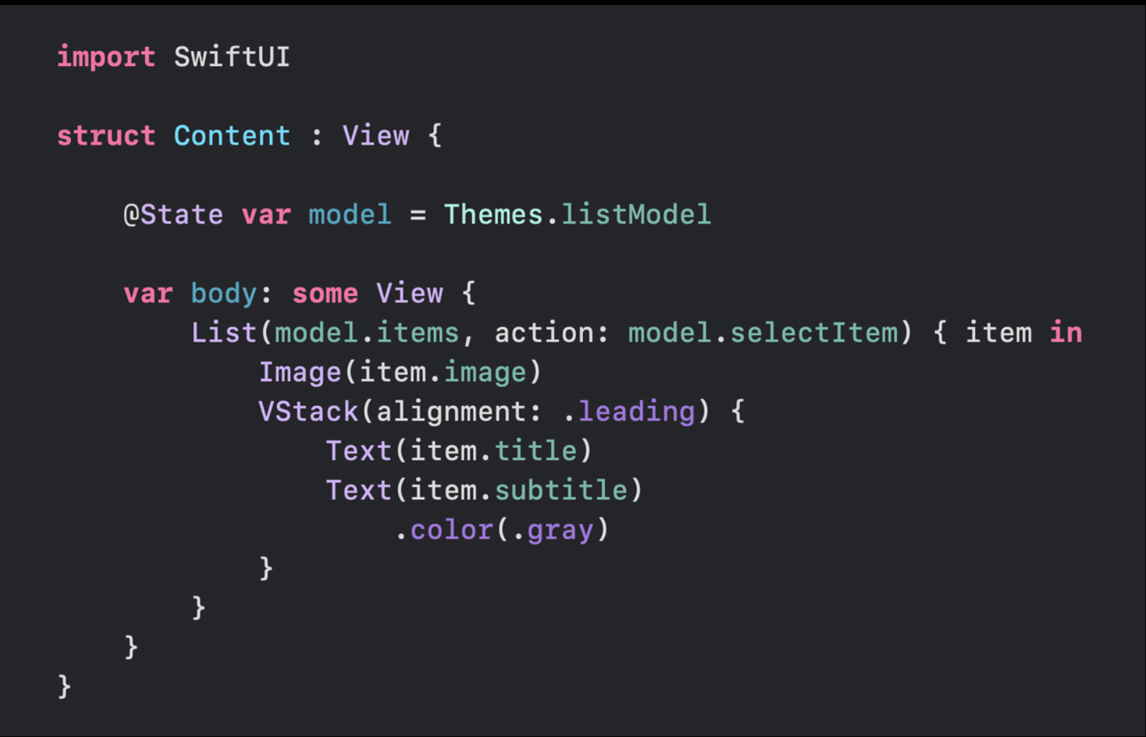
Declarative syntax
SwiftUI uses a declarative syntax, so you can simply state what your user interface should do. For example, you can write that you want a list of items consisting of text fields, then describe alignment, font, and color for each field. Your code is simpler and easier to read than ever before, saving you time and maintenance.
https://developer.apple.com/xcode/swiftui/

Slide 4
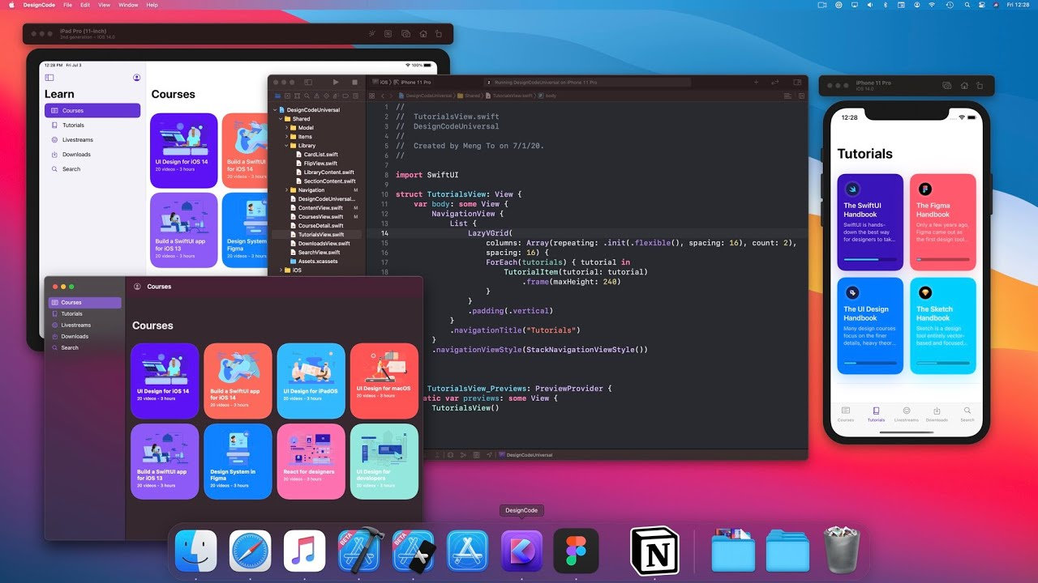
Personal overview
Widgets or block compilation programming language
Decrease building time 80%
SwiftUI preview is a beautiful tool
When you need a customize implementation you can link UIKit elements with SwiftUI
VHZStacks and Spacer() are your best friends
DesignCode, Jul 4, 2020
https://developer.apple.com/xcode/swiftui/

Slide 5
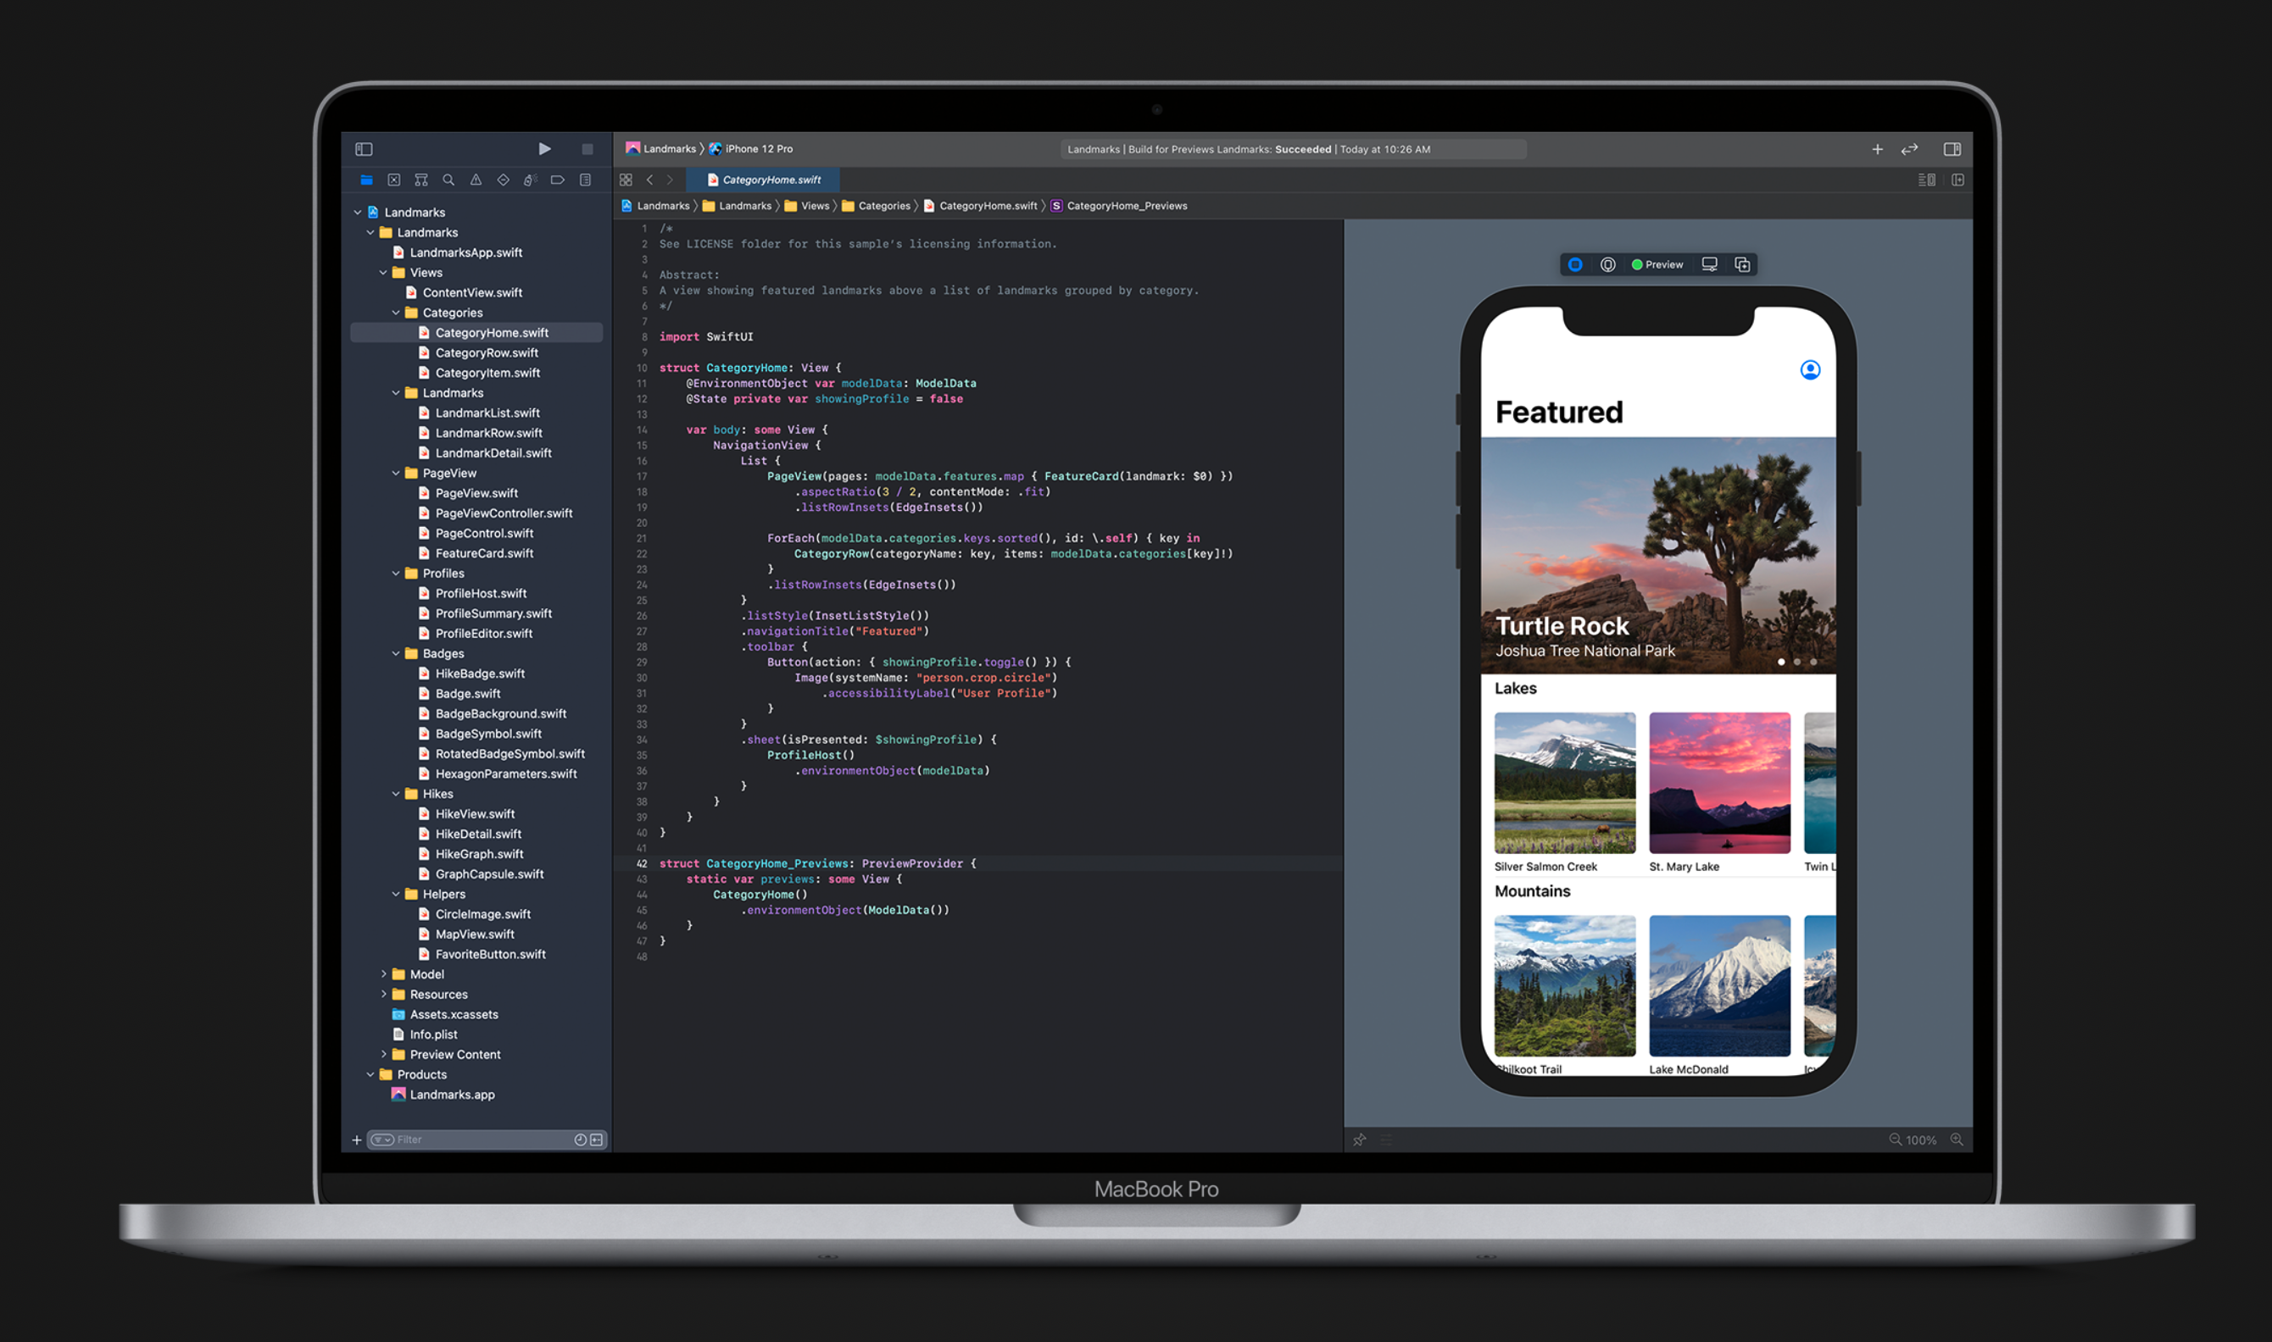
Documentation
https://developer.apple.com/documentation/swiftui/
https://developer.apple.com/tutorials/swiftui
Literally search “<Input view here> in swiftUI” in Google and will appear a lot of posible ways to do what we want.
https://developer.apple.com/xcode/swiftui/

Slide 6
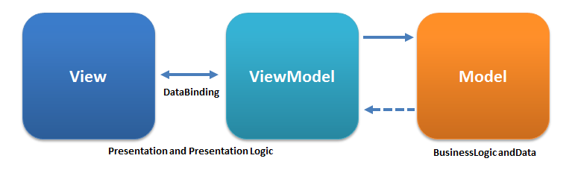
SwiftUI ❤️ MVVM
adictosaltrabajo.com/2020/06/05/patron-mvvm-en-swiftui/

Slide 7
Data Binding
Without @State we wouldn’t be able to change properties in our structs, because structs are fixed values.
Without StateObject we wouldn’t be able to create classes that stay alive for the duration of our app.
Without @EnvironmentObject we wouldn’t be able to receive shared data from elsewhere in our app.
Without ObservableObject we wouldn’t be notified when an external value changes.
Without $property two-way bindings we would need to update values by hand.
https://developer.apple.com/xcode/swiftui/

Slide 8
DEMO
https://github.com/andresparejo/GlobantUniversitySwiftUISample/tree/main

Slide 9
Thanks

